Slide 1


Presented by USCMO
OPEN MOSQUE DAY
These easy to follow tips will help your community plan and execute a memorable Open Mosque Day.

Slide 2

INVITE
1
2
3
4
5
Prepare a list of potential invitees with the enthusiastic support of the management team and fellow members of the Mosque.
Let your imagination soar and don’t restrict yourself when brainstorming potential guests!
Give notice well in advance, considering everyone’s busy schedules.
Ensure that your key invitees receive personalized invitations that outline all the exciting details of the open day.
Follow up with a warm and personal phone call to extend a heartfelt invitation.

Slide 3

WHO TO INVITE:
  Muslims around the Mosque
  Non-Muslims who live around the Mosque
  Faith communities, which have religious centers in the neighborhood.
  Police or police community officers
  School teachers and children
  District leaders
  Imams from the other Mosques in your area.
  Mosque committee members of other Mosques
  Fire department officers
  City and County officials
  Community voluntary agency leaders
  Women’s group leaders Muslim and non-Muslim
  Political party representatives
  Youth leaders
  Business leaders
  Members of the deaf community (make sure they come with a sign language translator)
  Counselors and advice center representatives
  Homeless center representatives
  Charity organization representatives, e.g. Islamic relief, Helping Hand, ICNA Relief, etc.
  Religious leaders from other faith communities
  Representatives from cultural groups
  Hospital representatives
  Hospice or retirement center representatives
  Doctors, dentists, maternity and outpatient clinics, NHS/Trust leadership

Slide 4
PROMOTE
DON’T FORGET THE POWER OF DIGITAL!
1
2
3
Use our media release and customize it for your event. Send to the local print and broadcast media, sharing the wonderful happenings at your Mosque.
Utilize your Mosque notice board and internal newsletters to ensure that the Mosque open day receives ample publicity within your own community.
Extend the invitation to other local houses of worship, including churches and temples, as well as reaching out to nearby Mosques and their esteemed leadership.
01
Update your website with event details and clear instructions for those who wish to attend.
02
Include the contact information of the responsible individuals who can provide further assistance.
03
Create a Facebook event and share with your friends and family.

Slide 5

01. Welcome Guests at the Door
PREPARE
Have friendly greeters at the door to direct arriving guests and to make them feel welcome.
02. Lead Tours & Answer Questions
Ensure knowledgeable, friendly volunteers conduct tours of the facility and answer any questions as they arise.
03. Be Ready to Share & Educate
Be prepared to discuss the Mosque and the religious rituals you carry out.
04. Welcome Women Guests
Make sure sisters are available to make female guests feel welcome.
05. Prepare & Brief Your Team
It is important to brief all those involved with the open day in advance of your guests arriving.
06. Open with a Welcome Presentation
Consider giving a presentation or welcoming speech at the beginning of the event to create a welcoming atmosphere.

Slide 6
DAY OF EVENT
1
2
3
4
5
6
Greet your guests before they enter the mosque and share Mosque etiquette via handouts. Remember for some of your visitors this will be the first time they have been in a Mosque and they may well have some misconceptions about etiquette and customs.
Have name tags & markers ready so guests can write their own names to feel comfortable.
Be ready to answer questions about prayer, separation of men and women and other common issues
Have signs from where guests may park their car to the designated entrance of the Mosque, especially if you have separate entrances for males and females. Many of them have never been to a Mosque before and may be nervous of offending their host.
Some guests may not wish to follow the official guided tour and wish to explore the Mosque on their own and take time to ponder on what they are observing, give them space and do not hurry or force anyone.
Provide a translator for when the adhan (call to prayer) is heard or when the Salah (5 daily prayers) is conducted. This can be a very moving and deep experience and a responsible person needs to be on hand to explain the rituals and their significance in Islam.

Slide 7
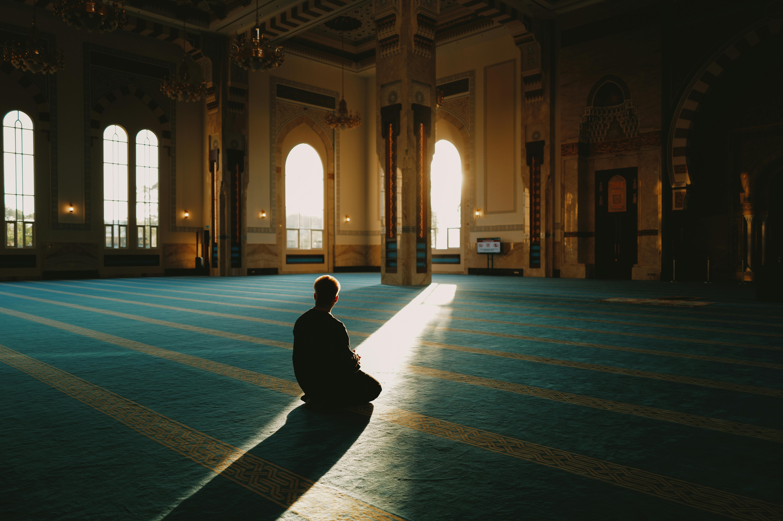
Upon Entering:
  Kindly remove your shoes.
  Men and women are encouraged to dress modestly, just as one would entering any other place of worship.
MOSQUE ETIQUETTE
Inside the Mosque:
  Maintain a quiet and serene atmosphere within the mosque. Ensure that mobile phones are turned off, refrain from chewing gum, and avoid bringing food or drinks inside.
  Avoid walking in front of someone who is praying.
  Join friends and community members in appropriate designated areas assigned to men, women, or children.
  Embrace a learning mindset

Slide 8
By following these friendly and inclusive approaches, we can make the Mosque open day a truly inviting and memorable event for all. Let’s join hands and spread the warmth of our community to welcome everyone with open arms.
Remember to send pictures from the event, including the mosque’s name, city, and state, to info@uscmo.org. Tag us on social media so we can reshare!

Slide 9

USEFUL RESOURCES FOR MASAJID TO GET MATERIAL FOR OPEN MOSQUE DAY
  WHYISLAM – www.whyislam.org - Provides concise literature on Islam
  FURQAAN FOUNDATION – www.furqaanfoundation.org – Provides Islamic literature and translated copies of “Clear Quran” to the public
  GAIN PEACE – www.gainpeace.com – provides concise literature on Islam

